Slide 1

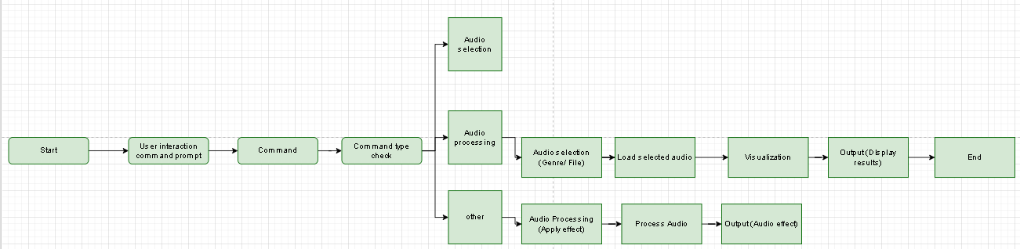
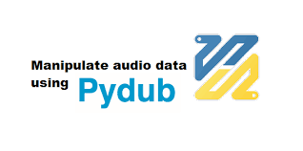



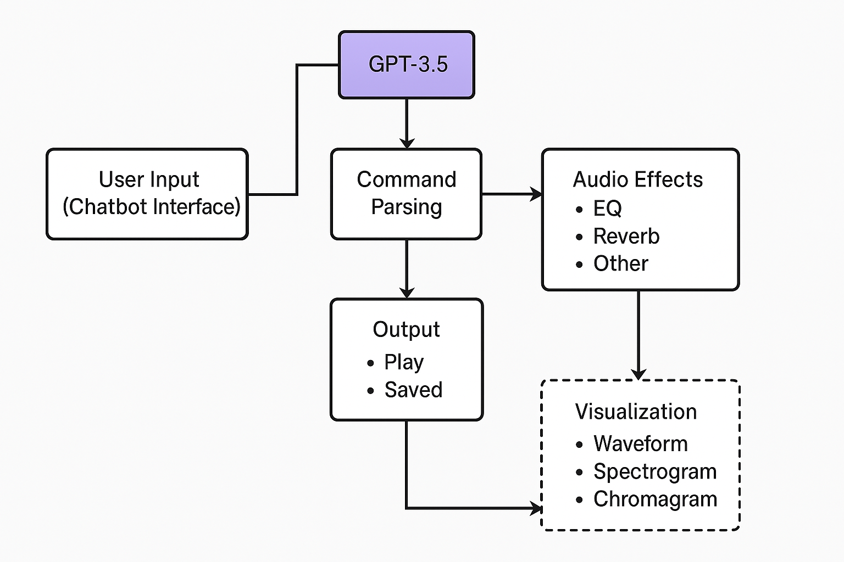



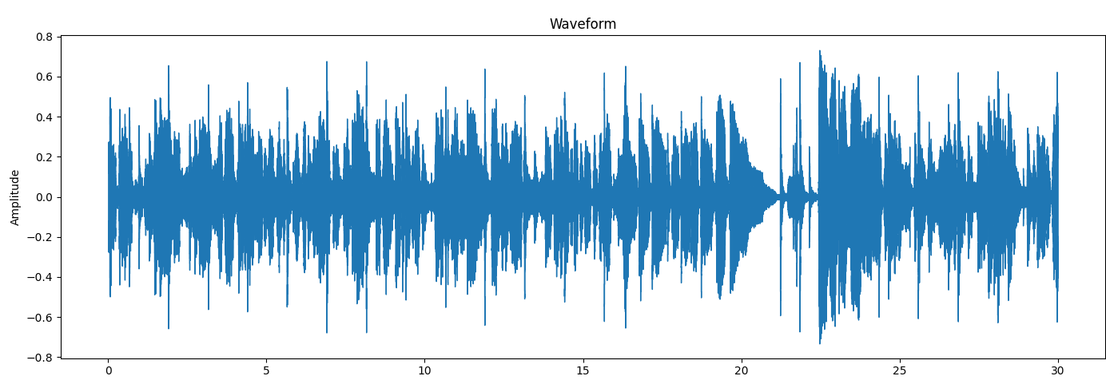
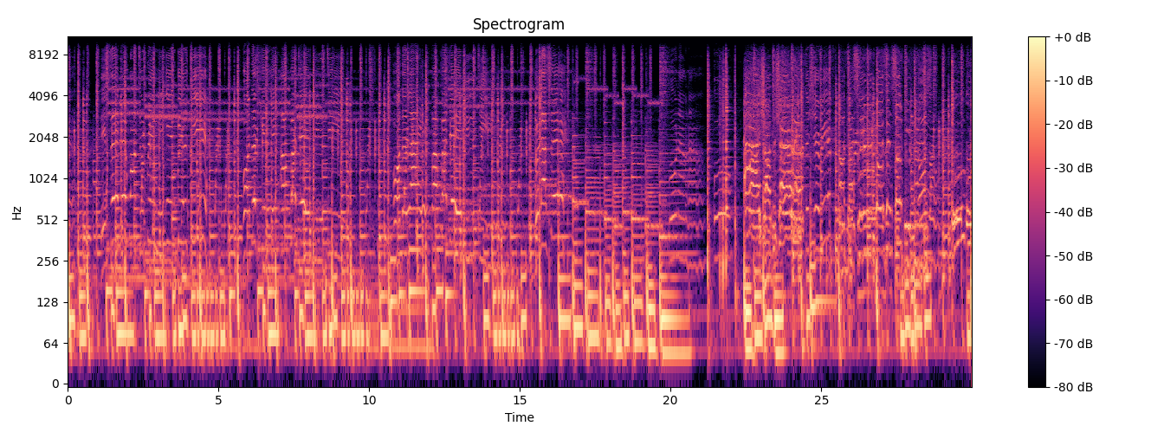
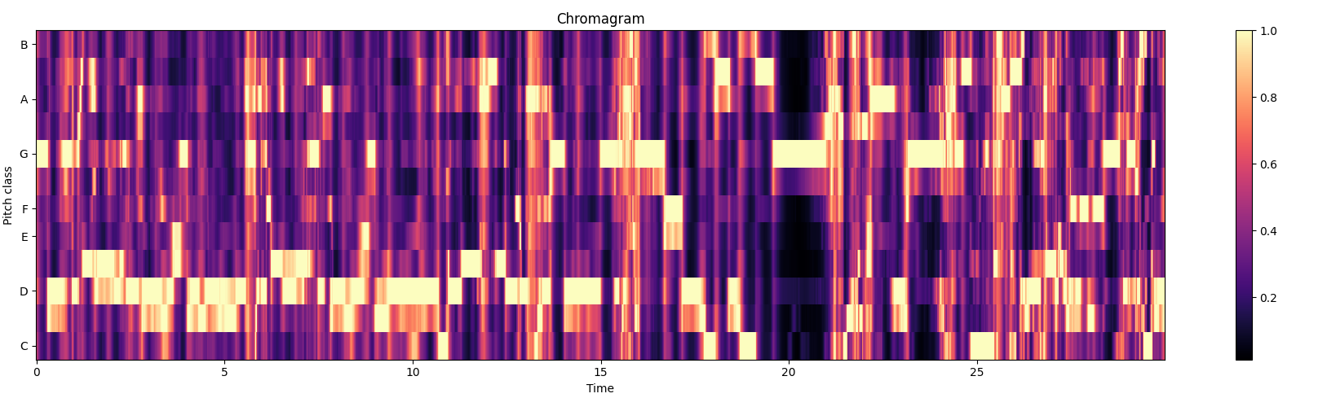
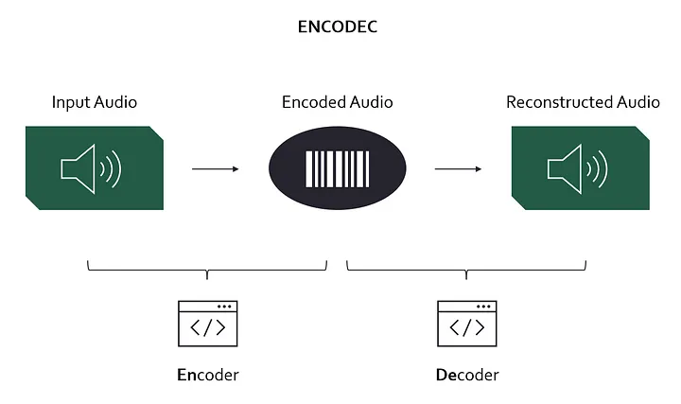

AI Driven Beat Analysis
Youssef Abbas
Dr. Amir El-Ghamry
BSc Computer Science
SCHOOL OF ENGINEERING & COMPUTER SCIENCE
Abstract
Block Diagram / Flow Chart / Use Case / etc…
Purpose: To develop an AI-driven tool that shows real-time exploits of audio effects cooperating with a chatbot which provides genre-based production recommendations.
Methods: Employ machine learning models, audio processing libraries such as Librosa and PyDub, and a GPT powered chatbot
Results: Successful implementation on the user-friendly chatbot which applies basic audio effects
Conclusions: The tool successfully interprets commands and applies audio effects, with future work concentrating on robust libraries
Introduction
Background: The growth of AI in music production and the want of instinctive tools for manipulating audio effects in real-time.
Motivation: To create a tool which assists producers and musicians in enhancing their music productions by exploiting AI for genre planning and tips on designing sounds.
[Methodology sub header]
Conclusion
1. PyDub: Audio playback and manipulation.
2. Spleeter: Stem separator (bass, drums, vocals, instruments).
3. sounddevice: real-time audio playback.
4. Ffmpeg: Reliable open-source media used for converting, audio decoding, and saving files.
5. Pycharm: A program developed by JetBrains; an integrated development environment (IDE) created for Python development.
6. TensorFlow: Used for machine learning development.
7. Python: All the codes and models are written in Python as it’s widely used in machine learning and deep learning due to its simplicity.
8. GPT 3.5: A natural language processing and chatbot functionalities.
9.Scikit-learning: Contains efficient tools for machine learning such as regression.
The AI-Driven beat analysis tool successfully understood the commands and related audio effects shown in real-time. It produced genre-based production tips to enhance audio and showed user-friendly for exploiting the audio effects. Not only achieved approximately 75% of the accuracy in command recognitions but also minimized optimal delay to around 200ms for best performance.
Future work:
Explore more precise and robust libraries such as PedalBoard or Sox for better audio processing. Apply cloud-based audio engines to handle much larger datasets and more complex tasks. Develop tempo detection and AI voice separation. Finally, implement a user’s feedback for more for continuously improving the tool’s response and accuracy .
Objectives
Objective 1: Developed a user-friendly GPT powered chatbot connection to control audio effects using natural languages.
Objective 2: Achieved around 70% accuracy in command recognition.
Objective 3: Minimized delay around 200ms for optimal performance.
Objective 4: Integrated real-time audio manipulations such as reverb, reverse, eq, pitching, loop.
Objective 5: Execute a user’s feedback mechanism to improve the accuracy and responsiveness of the chatbot
Fractional Filter 1
Fractional Filter 2
Methodology
Results
TABLE I: FPGA Design Utilization Summary
FPGA
Implications
Data Collection: GTZAN (Music Genre Classification)
Data Pre-processing: Segmentation: sliced into 30 second clips. Normalization: Audio files normalized to ensure amplitude levels. Conversion: MP3 converted to WAV for saving files and for better compatibility. Noise Reduction: Basic techniques applied for optimal quality.
Methods Used: Feature Extraction: Librosa used for extracting tempo, vocals, and rhythm. Machine learning models: Scikit learn and Tensorflow for audio effect manipulation and for genre predictions. Chatbot: A basic GPT 3.5 powered chatbot integrated for real time audio exploits.
Steps Taken: Data loading: Loaded audio files from GTZAN. Preprocessing: Normalized, segmented, and converted audio files for saving progress. Model training: Trained and cooperated model using Tensorflow and Scikit-learn. Feature extractions: Extracted all features using Librosa. Chatbot integration: created a chatbot interface using GPT 3.5. Effect Application: Implemented functions such as EQ, reverb, shift, pitching, etc. Testing and verifying: Measured response time, output quality, and command accuracy
Tools Employed: Python libraries (Librosa, PyDub,SoundDevice, TensorFlow, Scikit-learn), GPT 3.5, Spleeter which is a stem separator for drums, vocals, bass, and other instruments.
Analysis Methods: Genre prediction: Machine learning to predict the genre depending on the feature. Effect exploit: Applied multiple audio effects using Librosa and PyDub. Performance Metrics: Measured response accuracy and and time of the chatbot’s interface. Visualization: Created spectrograms, waveforms, chromographs to analyze sounds and effects.
The AI-drive beat analysis showed numerous advancements in the dominion of music, production, especially in audio exploits. It includes:
AI integration: By incorporating tempo detection and AI voice separation, this tool showed more evolvements such as separating components of music such as vocals, bass, drums, and instruments.
Scalability: enabling the tool to rely on much larger datasets and more difficult audio tasks, providing smoother performance and quality.
Educational Potential & Real Time Collaboration: provided opportunities such as interactive learning and collaborations between producers and musicians can share work on the same platform, can provide as an educational item which provides guidance and additional sound designs and techniques
References
GTZAN Dataset
https://www.kaggle.com/datasets/andradaolteanu/gtzan-dataset-music-genre-classification
Deep Learning for Audio – Bengio et al. (April 2019)
https://www.researchgate.net/publication/332799326_Deep_Learning_for_Audio_Signal_Processing
DAFX: Digital Audio Effects – Zölzer (2011)
https://dafx.de/DAFX_Book_Page/index.html
MusicGen Reimagined: Meta’s Under the Radar Advances in AI Music – Max Hilsdorf (November 2023)
https://medium.com/data-science/musicgen-reimagined-metas-under-the-radar-advances-in-ai-music-36c1adfd13b7

